Slide 1


PS NO: 28 E_Commerce Sales Analyzer
Rungta International Skills University
Submitted By
Submitted To
Priyansu Raj
Mr. Priyanshu
ERP NO. RU-26-00087
IBM SME
B.Tech 1st Sem IBM

Slide 2
Introduction
A Python-based project that reads online sales information from a CSV file.
It cleans the data and calculates important sales statistics.
It identifies top-selling products and category-wise revenue.
It displays the analysis through charts so that results are easy to understand.

Slide 3
Project Description & Problem Statement
E-commerce companies generate large amounts of order and sales data.
Manually calculating revenue, orders, units sold, and product performance takes time.
Raw CSV data can contain invalid or duplicate records.
The project analyzes the data automatically and presents clear, useful results.

Slide 4
Technology & Tools Used
Technology | Purpose
Python 3 | Main programming language
Pandas | Reads, cleans, groups, and analyzes CSV data
CSV | Stores order and product information
Matplotlib | Creates bar charts and pie charts
Aggregation / groupby() | Calculates product-wise and category-wise totals

Slide 5
Working of the Project
Input CSV File: Load the sales data from the orders.csv file.
Data Cleaning: Check the records and skip invalid or duplicate rows.
Revenue Calculation: Multiply quantity by price to calculate revenue for each row.
Data Analysis: Calculate total revenue, total orders, units sold, and top-selling products.
Category Analysis: Calculate revenue for each product category.
Data Visualization: Display the results using bar charts and pie charts with Matplotlib.

Slide 6
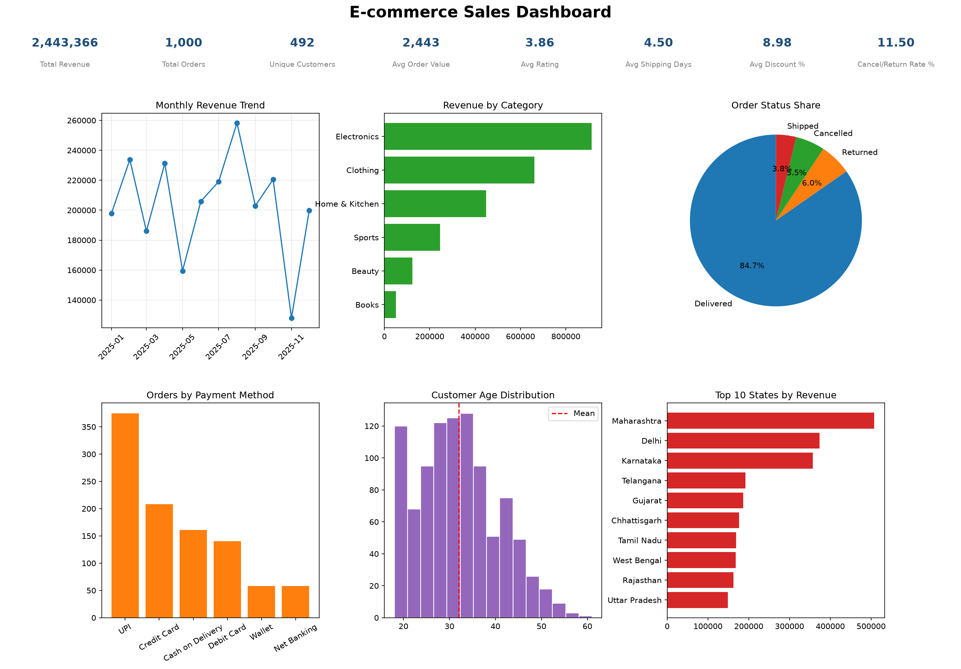
Project Screenshots

Slide 7
Thank You

